Slide 1


BE AN ENGINEER WITH A GADGETEER
Ruxandra Osman Anastasia Pachni-Tsitiridou

Slide 2
THE IDEA
Create a game using the gadgeteer(Fez Spider Mainboard) in which you can catch snowflakes using the joystick.
Implementation:
4 levels
Joystick control
3 lives
Easy to use interface

Slide 3
Difficulties and Solutions
Joystick control
Wrong calibration
Moved by itself
Moved with no consistency
If statement that removes functionality from the joystick when it’s in the center.
Recalibrating the joystick using “Calibrate();”
Increased the frequency of the GT.Timer

Slide 4
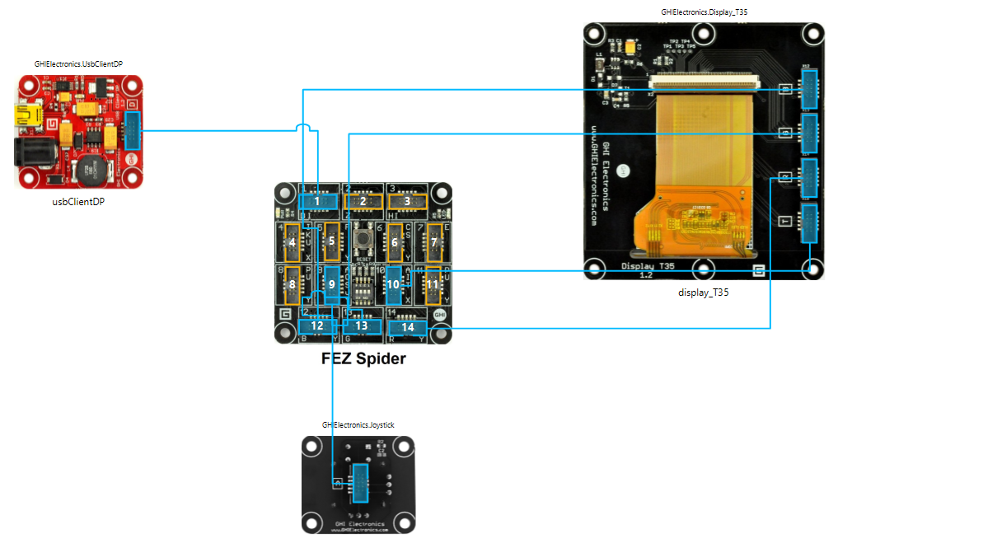
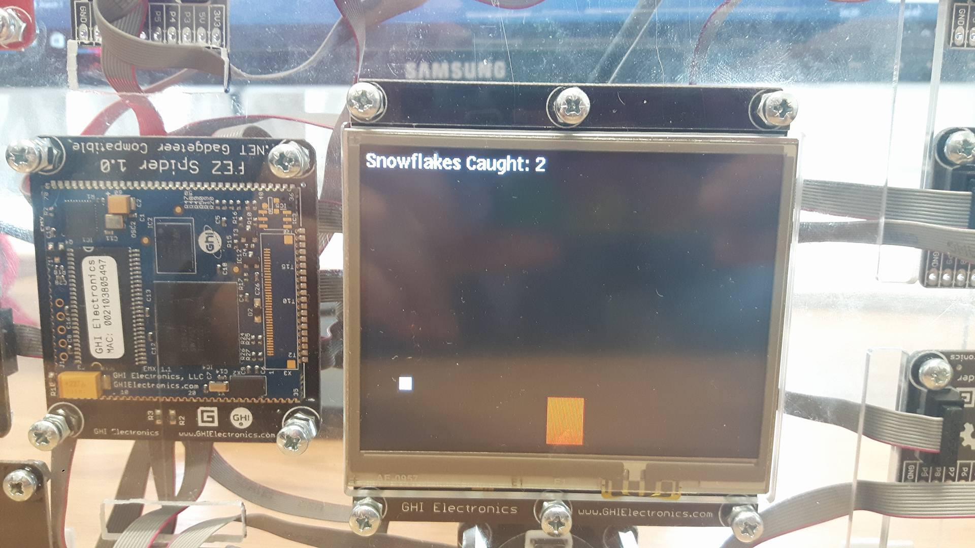
Graphic designing
Complication because we couldn’t draw a circle/star/snowflake
More research on that topic ☺
Using rectangles until we solve it

Slide 5
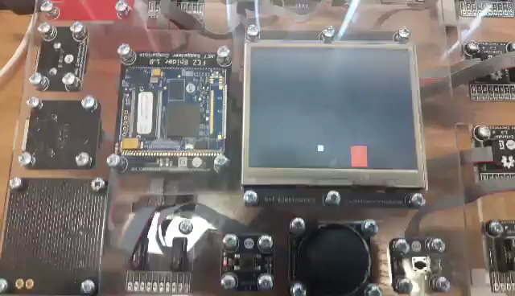
Ending the game
You can still play after losing all lives.
We didn’t have enough time to figure out how to solve this.
☹

Slide 6
Further Development
Solve the remaining problems
Make the game more difficult by increasing the speed of the falling snowflakes
Next levels: add more snowflakes by creating an array of snowflake objects
Adding a second player to the game by splitting the screen in half and adding a second joystick controller
Keeping score and making a scoreboard
Making the graphics better.

Slide 7
Thank you!

